Slide 1
Fifth Grade
Curriculum Night
Patterson Elementary
2023-2024

Slide 2

Classic Teachers
Mrs. Kross kross.julie@cusd80.com
​
Mrs. Chase chase.mary@cusd80.com
Ms. Spargo - spargo.serra@cusd80.com
Mrs. Taylor-Lee – taylorgraham.cristen@cusd80.com
Email is my preferred method of communication. Please allow me 24 hours to respond to your emails. Often, I will respond sooner.
I will email out weekly newsletters with classroom information.

Slide 3
School Information and Reminders
Parent-Teacher Conferences – August 23 & 24
No students on campus before 8:15 – soft start
Cell phones off and in backpacks (Smart watches off as well.)
Students will not be able to call home for homework/and or instruments
Mrs. Edwards – school counselor

Slide 4



Student Expectations
Complete student agenda in class daily
Adhere to school rules
Check grades at least once a week in Infinite Campus
Turn in missing/late assignments
Be proactive by seeing me for any questions/clarification with missing assignments

Slide 5

Online Access
Use Infinite Campus to access:
Online Gradebook
Use Clever to access:
Online Textbooks
Reading – Into Reading
Math – McGraw Hill – My Math
Online textbooks only accessible through student login, not parent login

Slide 6
Infinite Campus Login
Student
Username: s + student id
Password: s + student id!
PARENT
Follow directions given in the Parent Portal icon near the top right corner of the Patterson or CUSD home page. If you’ve forgotten your password, please call the Patterson front office or email peep.dawn@cusd80.com for assistance.

Slide 7
Curriculum
English Language Arts (ELA)
Reading, Writing, Language (spelling and grammar)
Music/Band/Orchestra
Meets 4 times every 6 days
Math
Physical Education
Meets twice every 6 days
Science and Social Studies
Taught in integrated units with ELA
Technology Lab
Meets once every 6 days
Social Emotional Learning
Media Center
Meets once every 6 days

Slide 8


Intervention/Enrichment
Moby Max
Small group instruction
Choice Boards
Defined Stem

Slide 9

English Language Arts
Textbook: Into Reading (Houghton Mifflin Harcourt)
Access online textbook through Clever - Ed icon
Emphasis on fluency, vocabulary, grammar, and reading comprehension strategies with a variety of texts
Spelling - weekly
Writing - Use of Thinking Maps to write opinion, informative/explanatory and narrative genres

Slide 10

Accelerated Reader (AR)
Students STAR test every quarter to receive their reading range and reading goal.
Goals are based on 30 minutes of independent reading daily, M - Th.
Students are acknowledged for reading achievement.

Slide 11
Math – McGraw Hill Textbook
Place value of whole numbers and decimals
Whole numbers – multiply multi-digit numbers and divide by 2-digit divisors
Decimals – add, subtract, multiply and divide
Write and interpret expressions
Fractions – add, subtract, multiply and divide
Compare fractions and decimals
Measurement – US Customary and Metric – convert units within each system
Geometry – Classify 2 and 3 dimensional figures
Geometry – Finding volume
Analyze patters
Graph points on a coordinated grid
Change fractions to decimals and decimals to fractions

Slide 12


Social Studies
American Revolution
Constitution
Westward Expansion
Civil War
Industrialization

Slide 13

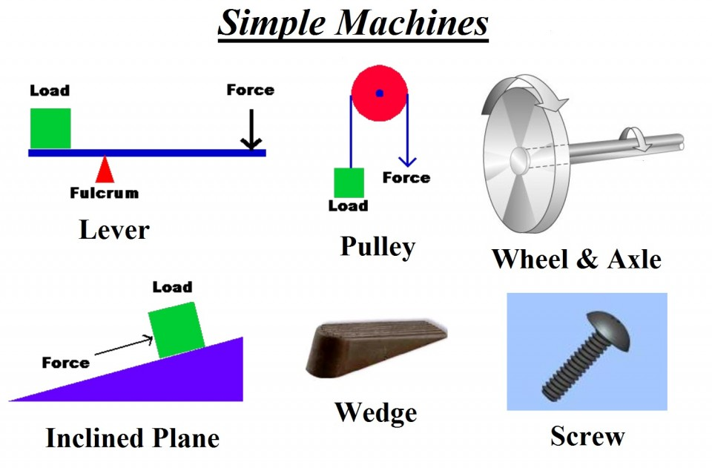


Science
Matter
Forces and Motion and Simple Machines
Sun, Moon and Earth
Inherited traits

Slide 14

Social Emotional Learning – Second Step
Second Step teaches students skills for learning, such as empathy, emotion management, and problem solving.
Social Emotional Learning (SEL) is the process through which children and adults can better understand and express emotions and empathy, develop positive relationships and make responsible decisions. The SEL curricula teaches children techniques that help them gain confidence, set and achieve positive goals, collaborate well, and navigate the world more effectively.

Slide 15

Students will be responsible to record classwork and homework in their agenda daily. CUSD advises that 5th graders should have approximately 50 minutes of homework a night (Monday – Thursday)
Homework may consist of:
  Practice of skills learned in class
  Unfinished class work
  Studying for tests
  Independent reading
  Practice typing

Slide 16

Grading Guidelines
Per CUSDS grading policy, the lowest grade a child may receive on any assignment/test is a 50%. If your child earns a grade below a 50%, the earned grade will be indicated on the assignment, but a 50% will be recorded in Infinite Campus.
Missing assignments will be indicated in Infinite Campus with an "M" for missing, and a 0% will be averaged into the overall grade in Infinite Campus until the assignment is turned in. Missing assignments can only be made up in the quarter they were missing.
Any graded assignments or math tests that receive a grade below a 70% may be corrected (on a separate piece of paper and attached to the original assignment) and turned back in to receive a grade of a 70% with a parent signature.

Slide 17

Healthy Students are Better Students
Students who eat healthy are more attentive, have a stronger memory, learn easier, and are in better moods.
During the day, students may enjoy a healthy snack brought from home
Some healthy foods include: cheese, nuts, whole grains, yogurt, fruit, vegetables, and hard boiled eggs.

Slide 18

Classroom Economic System
Our Classroom Economy is a system that helps to build your child's connections to real life situations involving community, responsibility and accountability.
Your child will...
have a classroom job, and earn class currency
use classroom currency to rent desk and purchase items from the classroom store or classroom auctions
have opportunities to earn bonuses
incur fines for missing work or unacceptable behavior

Slide 19


Slide 20


Slide 21


Slide 22

Social Media - Patterson

Slide 23


